Slide 1
Cap Store Application

Slide 2
Team.. S.P.S.S. Swaroopa - 152990 K. Ashritha - 153013 Sindhu Murali - 152993 I.P.S Prakash - 153008

Slide 3
MODULES
(26-30)

Slide 4
CapStore Home Page
Product Page
WishList
Similar Products
Notes:
Usar para separador de capitulos . Seria bom ter esta versao em vermelho e verde tb..

Slide 5

Cap Store Home Page
Menu which includes all categories.
After Selecting category it will show list of items.
Sorting and selecting items.
A search bar.
All the discounts and promos.
Notes:
O Logo de espadas deve ter mais espaço das pontas abaixo. Sugerir outros tipos de imagens/ telefone, fones.

Slide 6
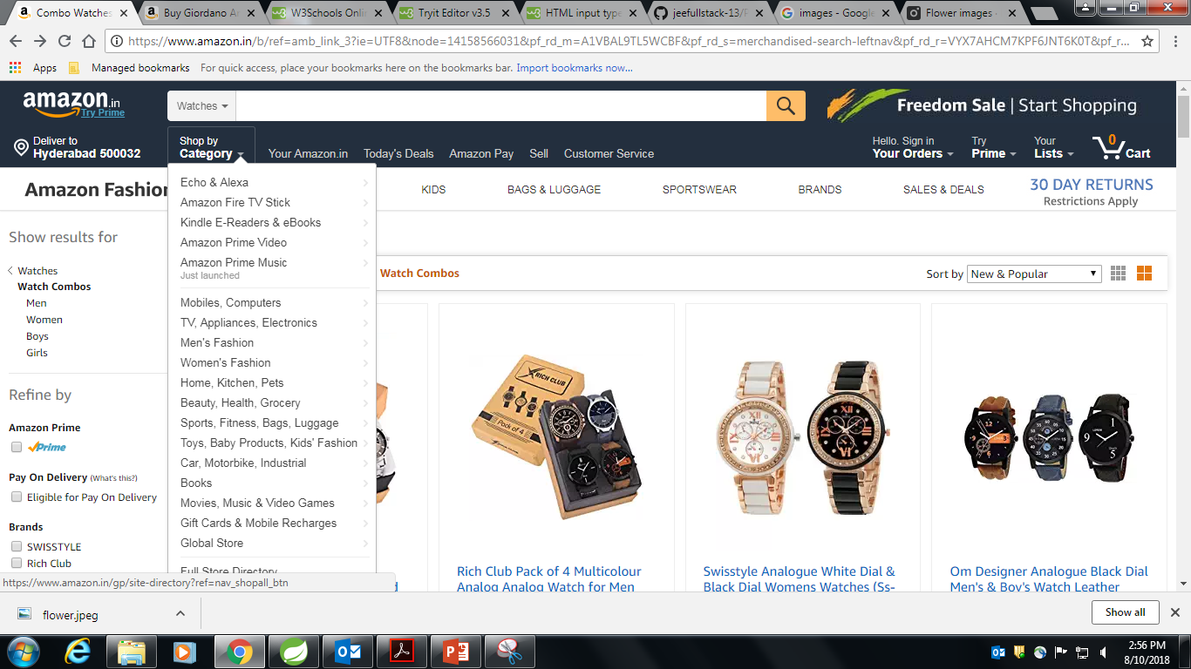

Slide 7
Product Page
Product Image
Product Name
Product Cost
Product Description
Buttons
Wish List
Add to Cart
Buy Now
Discounts/Coupons
Feedback /Rating
Similar Products

Slide 8
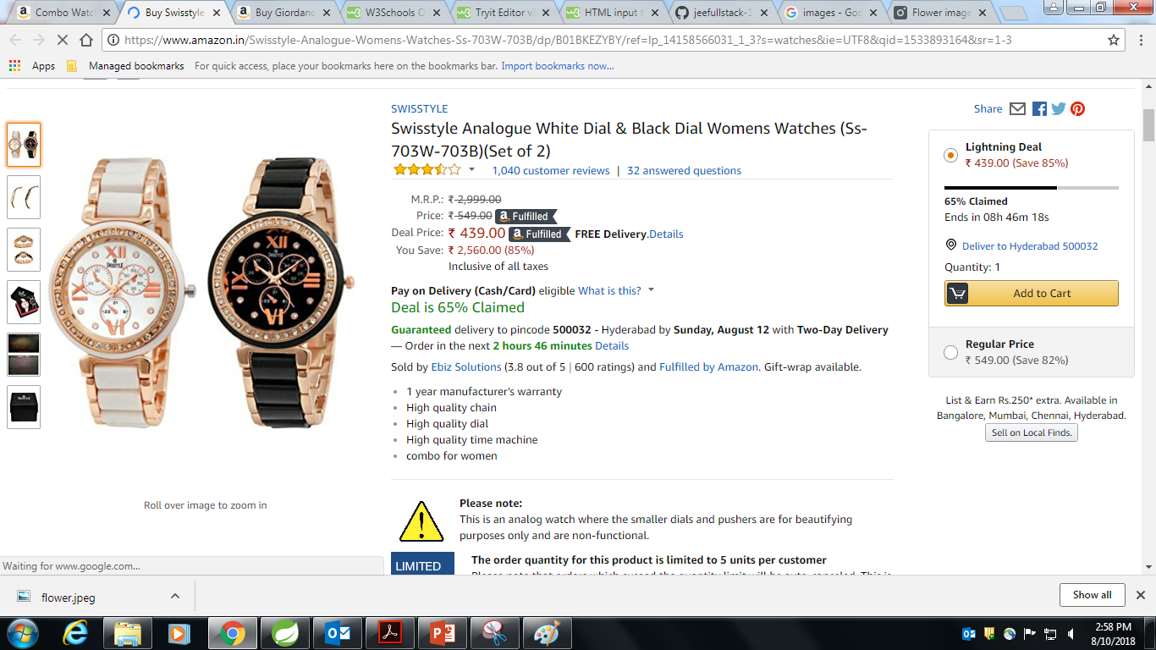

Slide 9
Wish List
Name | Data Type | Constraints | Description
Cust_id | Int | Foreign_key | Recognisation of customer
Product_id | Int | Foreign_key | To Recognize Products

Slide 10
Similar Products
Displays products of same category based on product name.
The product name will be taken from category.

Slide 11
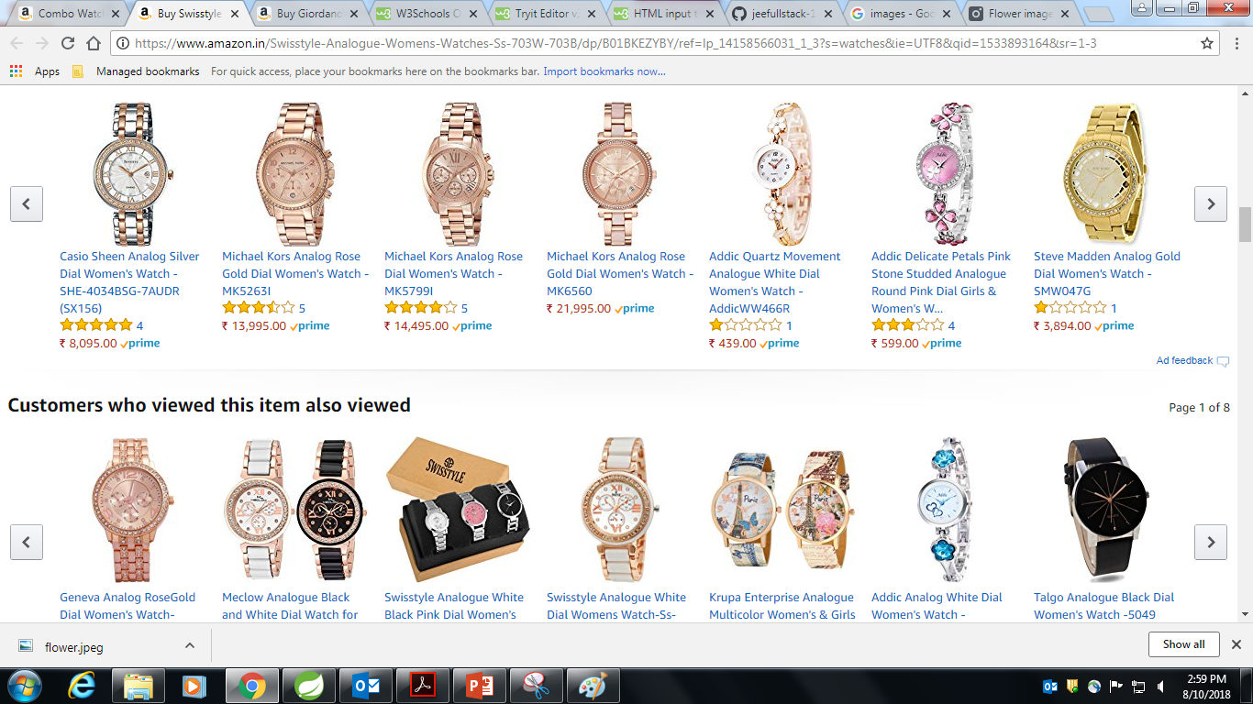

Slide 12
Thank You
Notes:
EVITAR usar o spada branco – tem que ser sempre o colorido.

